Slide 1
Image Synthesis
Computer Vision

Slide 2

example: DALL-E 2
idea: generate new images as variations of training data (same distribution)
usually conditioned on text (prompt)
compared to text generation, additional mechanism needed (e.g., diffusion) due to more complex image structures

Slide 3


plenty of products: DALL-E, Stable Diffusion, ImageGen, Midjourney, ...
web app for Stable Diffusion: DreamStudio
inpainting example (GLIDE ):
prompt
source

Slide 4

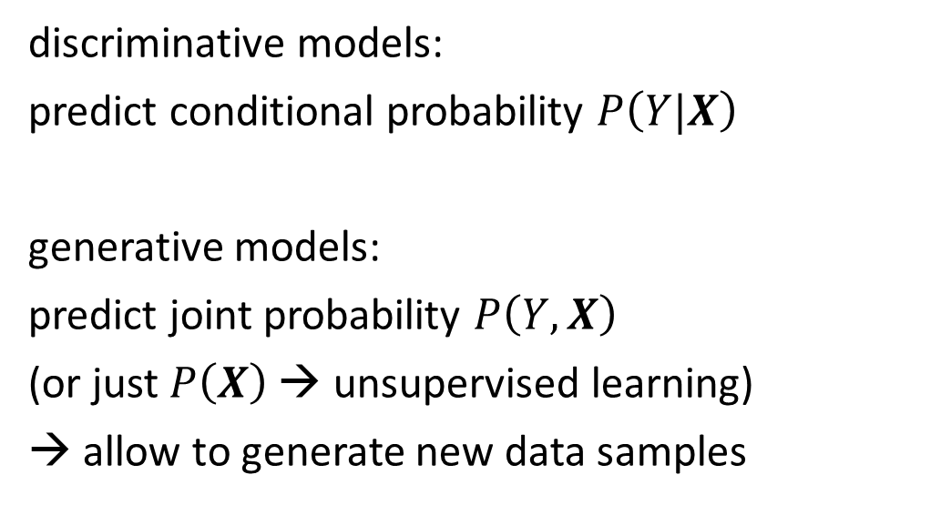
Generative vs Predictive/Discriminative Models
discriminative model
generative model
discriminative models:
predict conditional probability $P\left(Y|X\right)$
generative models:
predict joint probability $P\left(Y,X\right)$
(or just $P\left(X\right)$ → unsupervised learning)
→ allow to generate new data samples
source
task of generative models more difficult: need to model full data distribution rather than merely find patterns in inputs to distinguish outputs
Generative models can be used for predictive tasks (Bayes theorem).
But predictive models are usually better at it.

Slide 5
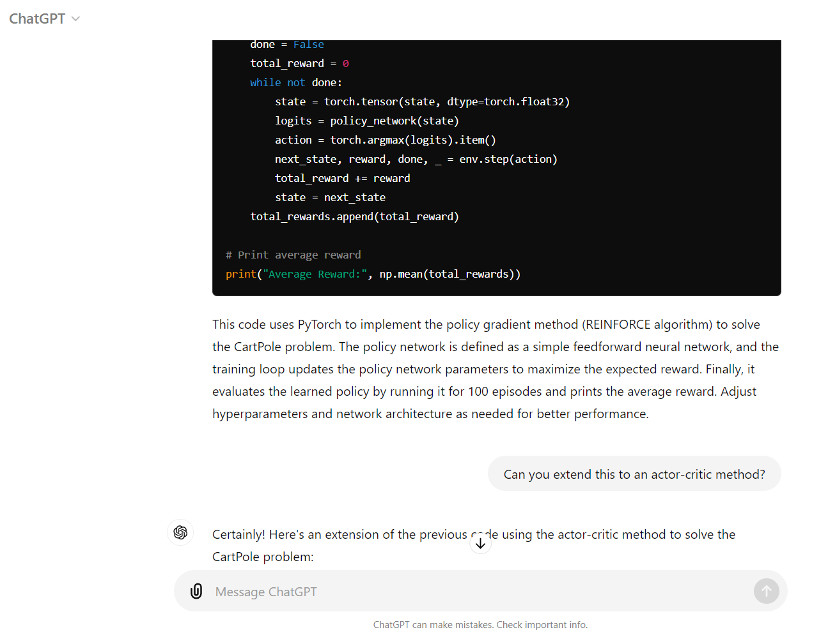
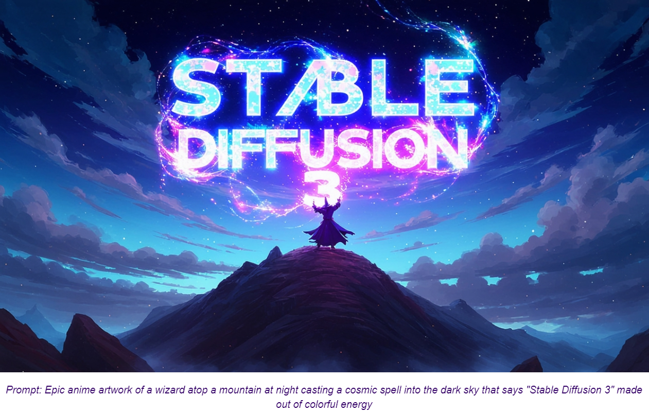
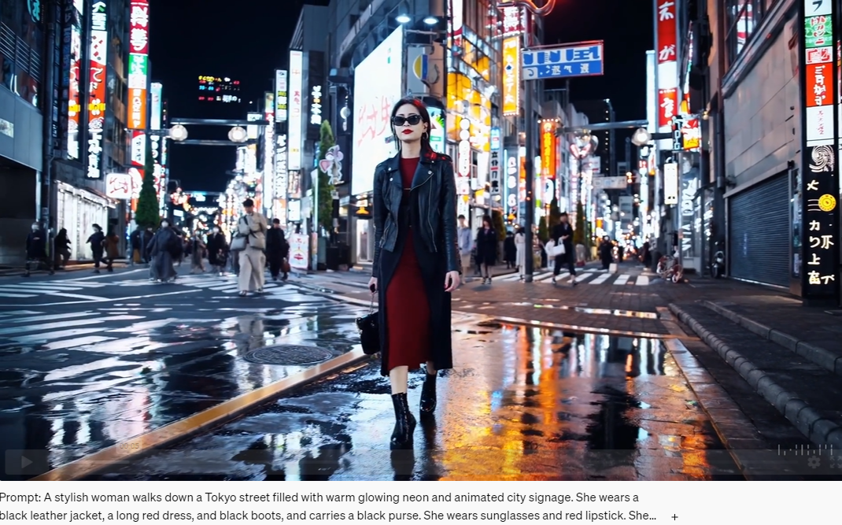
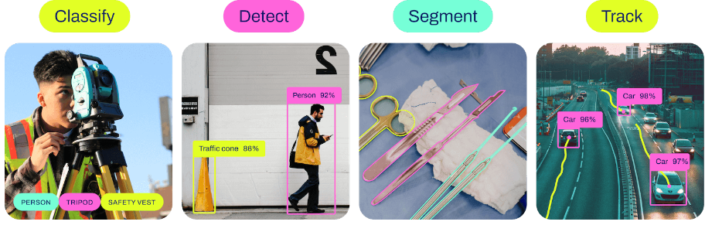
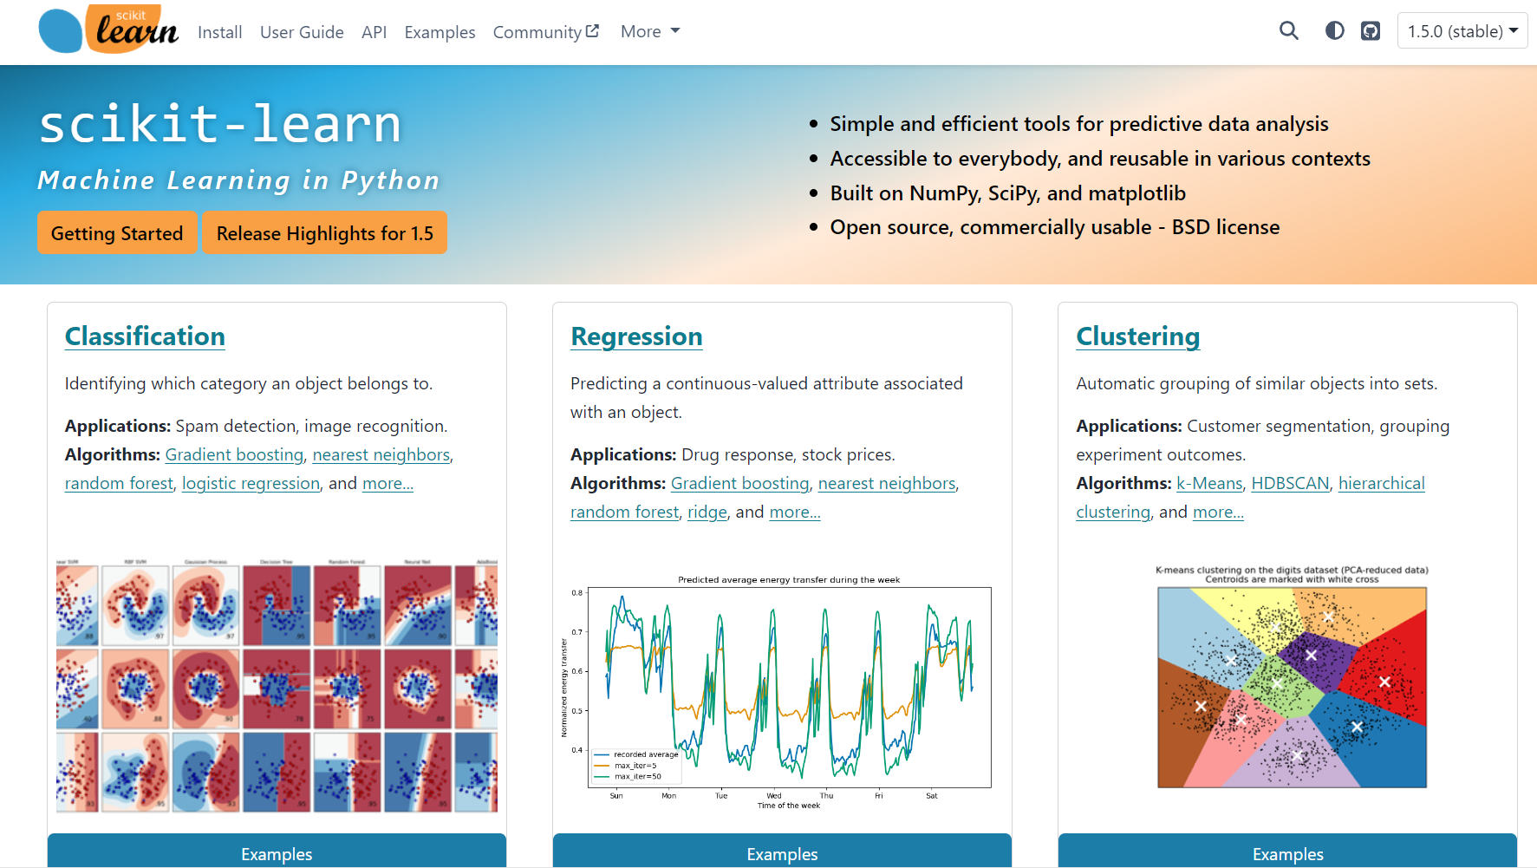

Classic ML vs Deep Learning
Generative vs Predictive Models
text generation
image synthesis
text-to-video
ChatGPT
Stable Diffusion 3 — Stability AI
Sora | OpenAI
BERT family
tabular data
computer vision
YOLO

Slide 6
Deep Learning for Generative AI
Depending on the application, there are currently two dominant approaches for generative AI:
text generation: decoder LLMs
image synthesis: diffusion models
note the difference between image synthesis and multimodal understanding in LLMs (images as additional input sequences to transformer, tokenized by splitting into patches)

Slide 7

Different Model Types for Image Synthesis
two neural networks playing a zero-sum game
learn variational distribution (not just replicating inputs)
more complex distributions by applying change-of-variable technique (need for specialized architecture)
chain of denoising autoencoders
→ generalization: flow matching
source

Slide 8
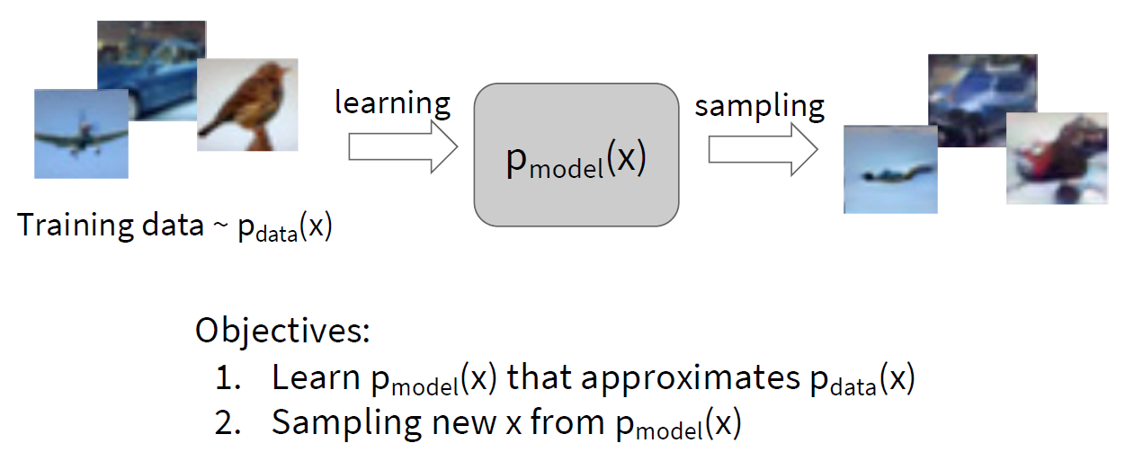
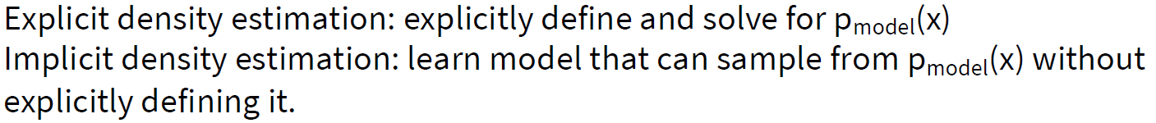
Generative Modeling

Slide 9

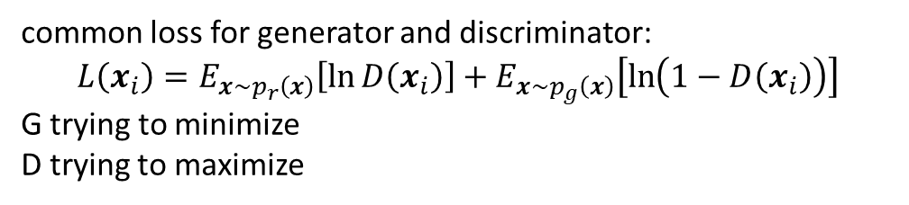
Generative Adversarial Networks (GAN)
two neural networks playing a zero-sum game:
the generator network G generating new (fake) samples
the discriminator network D trying to distinguish between real and fake samples
indirect training via D: G not trained directly to minimize reconstruction error of real samples, but to fool D → self-supervised approach
implicit density estimation
source
common loss for generator and discriminator:
$$L\left(x_{i}\right)=E_{x\sim p_{r}\left(x\right)}\left[\ln{D\left(x_{i}\right)}\right]+E_{x\sim p_{g}\left(x\right)}\left[\ln\left(1−D\left(x_{i}\right)\right)\right]$$
G trying to minimize
D trying to maximize

Slide 10
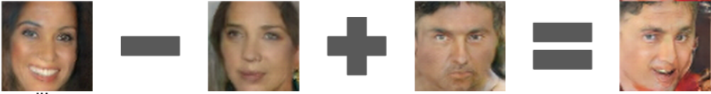
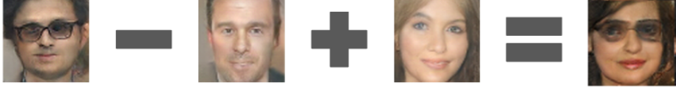
Vector Arithmetic in GAN Latent Space
smiling woman
neutral woman
neutral man
smiling man
source
man with glasses
man without glasses
woman without glasses
woman with glasses

Slide 11

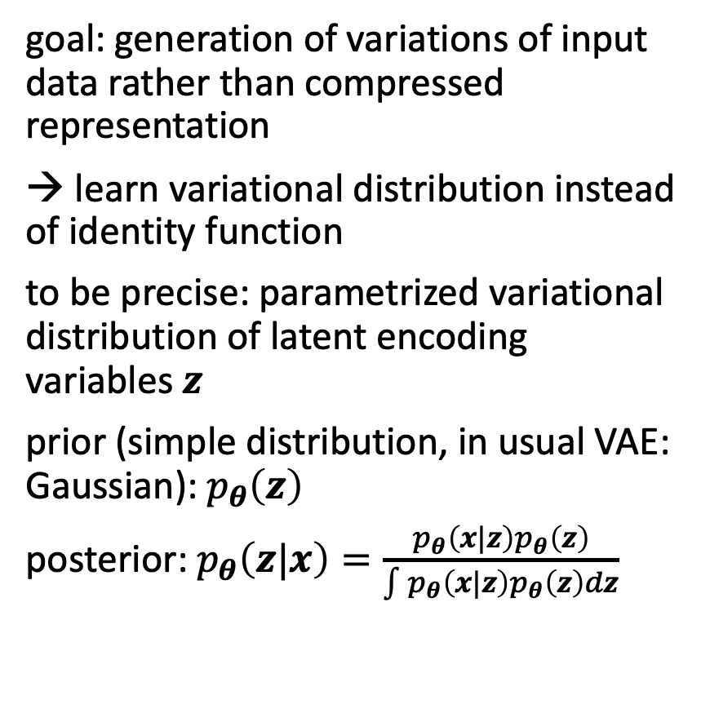
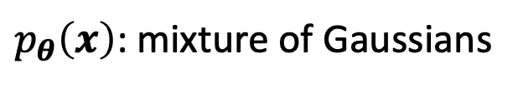
Variational Autoencoder (VAE)
goal: generation of variations of input data rather than compressed representation
→ learn variational distribution instead of identity function
to be precise: parametrized variational distribution of latent encoding variables $z$
prior (simple distribution, in usual VAE: Gaussian): $p_{θ}\left(z\right)$
posterior: $p_{θ}\left(z|x\right)=\frac{p_{θ}\left(x|z\right)p_{θ}\left(z\right)}{\int{p_{θ}\left(x|z\right)p_{θ}\left(z\right)}dz}$
from which to sample
Variational Bayesian Method
$p_{θ}\left(x\right)$: mixture of Gaussians

Slide 12

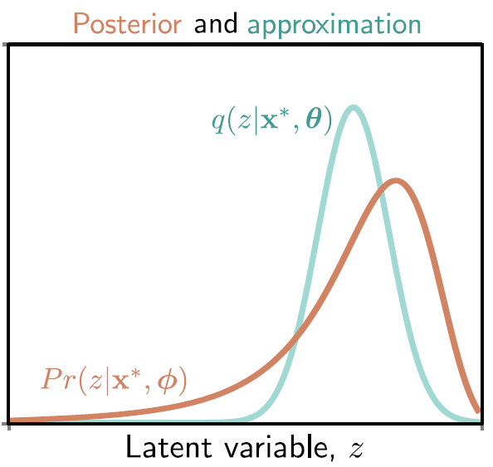
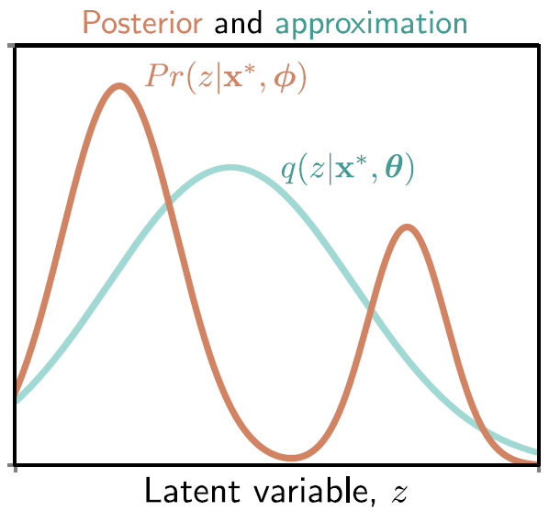
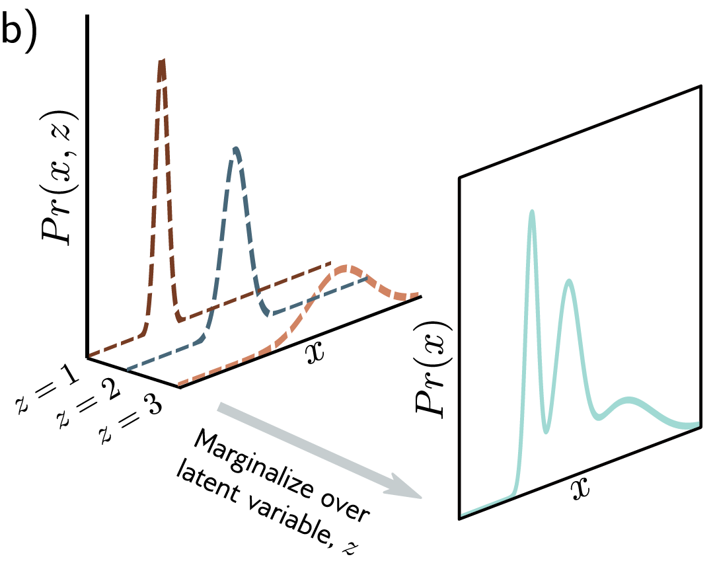
Gaussian Approximation
learn mean and variance of multivariate Gaussian with diagonal covariance structure
good approximation:
poor approximation:
source

Slide 13

Diffusion
training: distort training data by successively adding random noise, then learn to reverse this process (denoising)
generation: sample random noise and run through the learned denoising process
advantages: easy to train, produce high-quality/realistic samples
can be interpreted as special case of hierarchical VAE (one latent variable generates another) with fixed encoder and latent space of same size as the data
→ more sophisticated latent space than just Gaussian mixture in VAE
source

Slide 14
Diffusion as Chain of Denoising Autoencoders
differences of diffusion models to typical denoising autoencoders:
no bottleneck (care about output here, not internal representation): latent space with high dimensionality (same as original data)
handle many different noise levels with single set of shared parameters
important application: AlphaFold 3 uses diffusion-based architecture for protein structure prediction

Slide 15
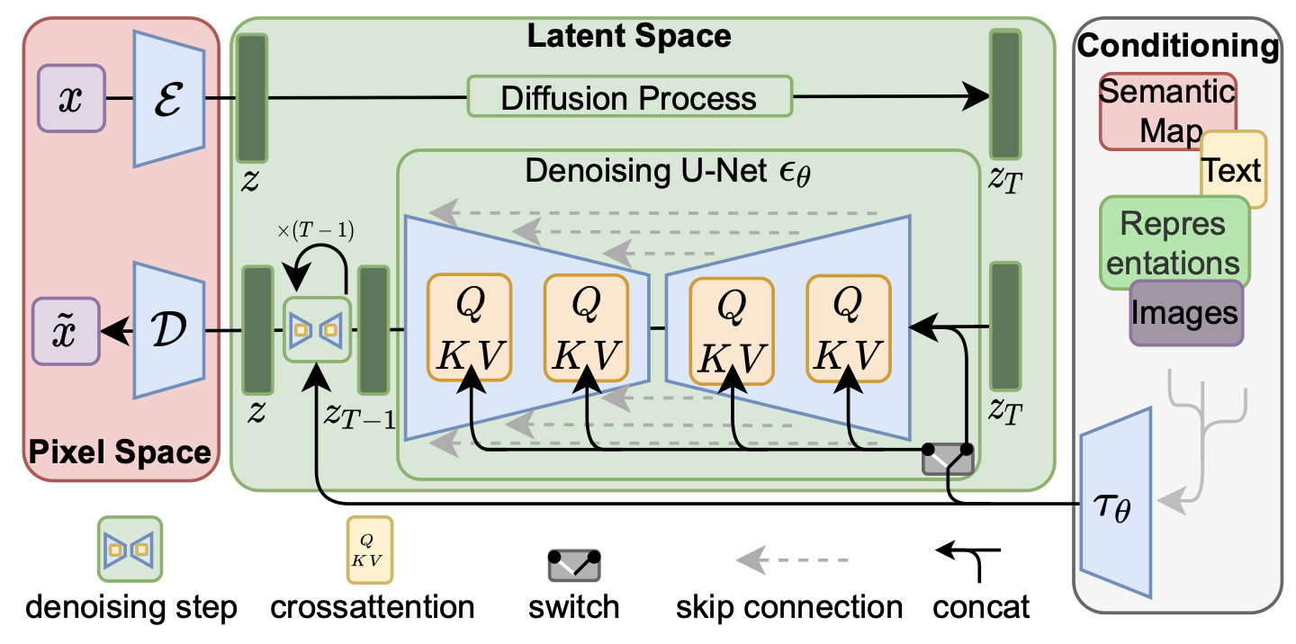
Latent Diffusion
add noise to latent representation rather than raw data
→ significant speedup
convolution and transposed convolution layers
skip connections between layers operating at the same scale
use of attention mechanism for flexible conditioning
alternative to convolutional U-nets: vision transformers (e.g., DiT)
source

Slide 16
Outlook: Text2Anything
next step: text-to-video (Make-A-Video, Lumiere, Sora, …)
→ rudimentary physics understanding
at some point maybe also generation of proteins, materials, …

